Slide 1


2nd MEETING OF
TODAY’S TOPIC
Foundation & Commitment
FOUNDER CHAPTER
Presentation By
SSEMBATYA SHAFIQ
Because in LBN Hub, we are not ONLY just building businesses…
👉 We are building a system.
👉 We are building a culture.
👉 We are building discipline.
And everything starts with a strong foundation.

Slide 2

LBN HUB – WEEKLY MEETING AGENDA
📅 Date: Saturday, 28th
⏰ Time: 7:00 AM – 9:00 AM
📍 Venue: SDMA Office – Najjanankumbi Stella
Opening Prayer
Opening Remarks (Executive Director)
Icebreaker Session
60-Second Member Introductions
Weekly Training / Open Discussion
Referrals Session
Testimonials & Closed Business
Testimonials & Closed Business
LBN Hub Updates & Announcements (Annual Launch of LBN – HUB)
Action Planning Session
Closing Session
AFTER-MEETING (Optional – 15 mins)

Slide 3
Opening Prayer
Commit the meeting to God
Set a focused and positive tone
Ask for guidance in every discussion, decision, and interaction. Invite wisdom, clarity, and understanding among members.
Ask for growth, provision, opportunities, and success in each member’s work.

Slide 4



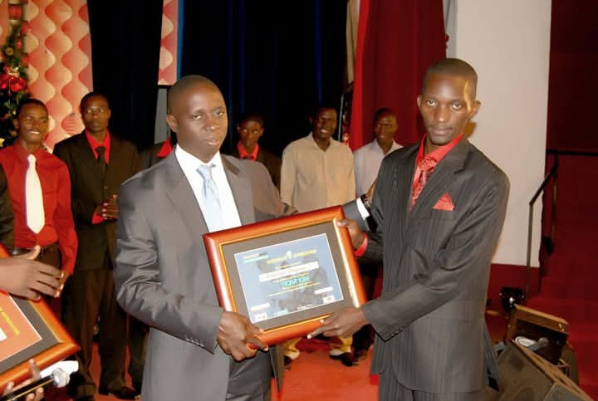

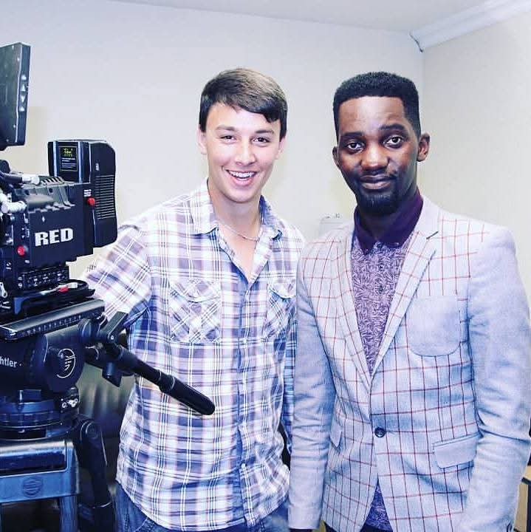
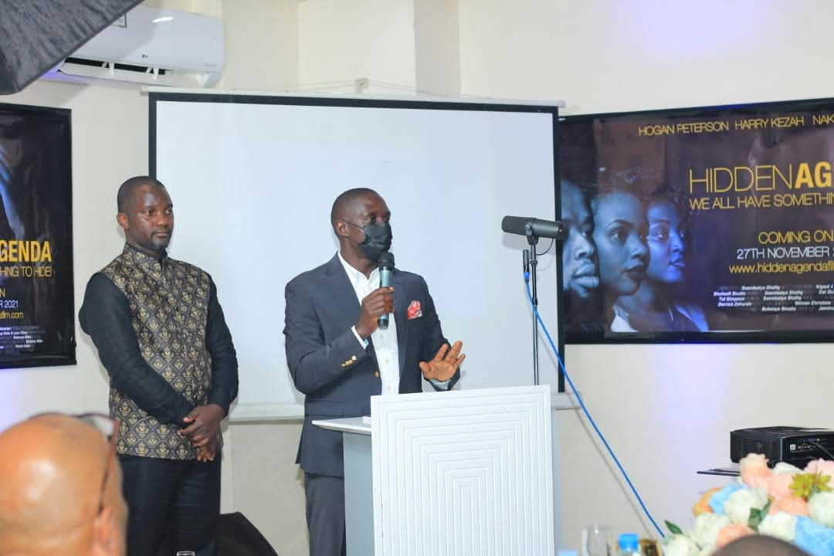


MY BIOGRAPHY
SSEMBATYA SHAFIQ – AM A FILMMAKER / DIGITAL MARKETING SURGEON
Official Launch of Ekiba Ekibe Film 2010
Hon Muhammad Nsereko Hand Over Certificate to Ssembatya Shafiq
At a Shoot with Ken Bleta in South Africa
Hon Muhammad Nsereko at Launch of Hidden Agenda Film 2021
Ssembatya Shafiq – Director LBN HUB

Slide 5
Attendance Discipline
Success in this network starts with one simple thing
(Showing up)
If you are not in the room:
You cannot give referrals
You cannot receive referrals
People forget your business quickly
Consistency builds:
✔ Trust
✔ Visibility
✔ Opportunities
In LBN Hub, attendance is not optional — it is your investment.
The more you show up, the more your business shows up in people’s minds.
Our percentage attendance is 75 % and above for any growing business

Slide 6
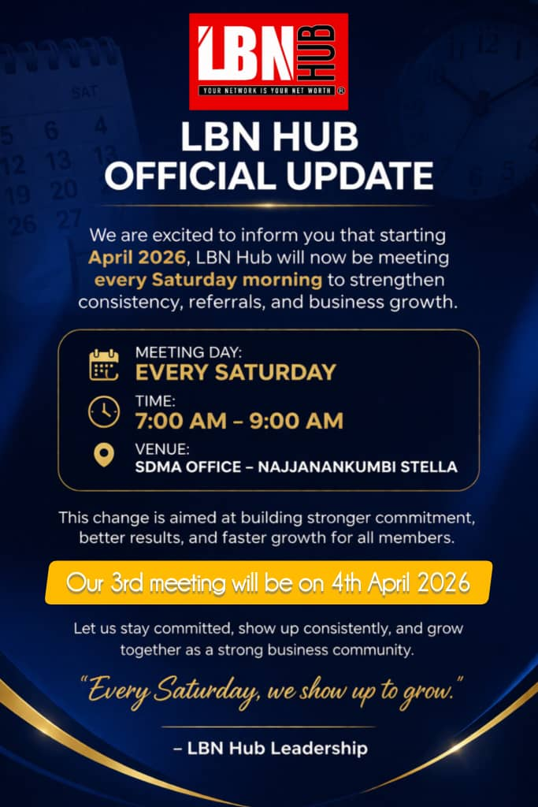
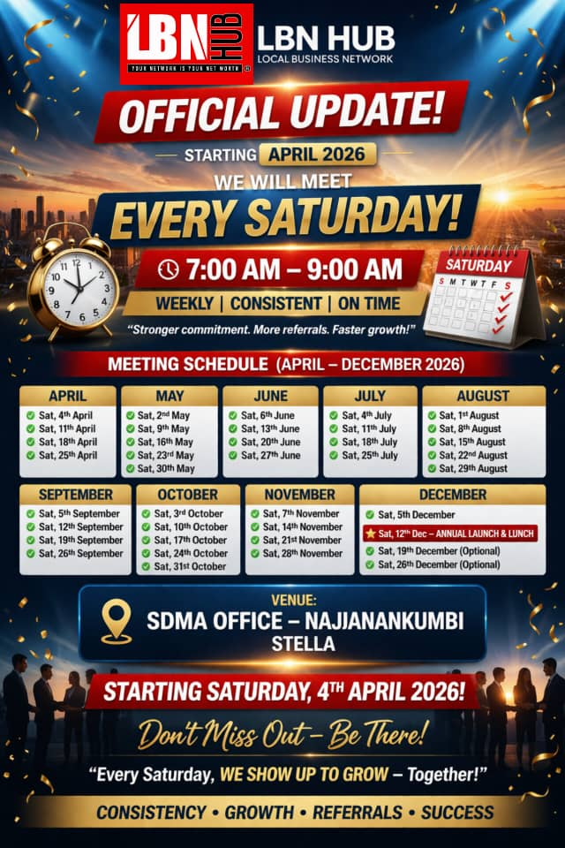
EVERY SATURDAY MEETING DATES CALENDER
Success in this network starts with showing up in every meeting

Slide 7

We are not here to sell to each other.
We are here to promote each other.
A good referral is:
-Specific
-Intentional
-Directed to a decision-maker
Not:
❌ “Anyone who needs…”
Understanding Referral Culture
LBN HUB OPERATES ON ONE MAJOR PRINCIPLE
👉 Givers Gain
FOUNDER CHAPTER

Slide 8
But:
✔ “I am looking for a school director”
✔ “I need a landlord building rentals”
✔ “I want a business owner who needs branding”
The clearer your referral, the faster your business grows.
Understanding Referral Culture
LBN HUB OPERATES ON ONE MAJOR PRINCIPLE
👉 Givers Gain
FOUNDER CHAPTER

Slide 9
Clarity of Presentations
Every time you stand to speak, remember:
👉 You are training your sales team.
If members don’t understand your business:
They cannot refer you
They cannot explain you
They cannot sell for you
So, your message must be:
✔ Clear
✔ Simple
✔ Specific
Always include:
What you do
Who you serve
What you are looking for
If your message is confusing, your referrals will be few.
FOUNDER CHAPTER

Slide 10
LBN HUB LEADERSHIP STRUCTURE
Executive Director (Top Leader / Founder ),Overall vision and direction of LBN Hub
Oversees all chapters and leadership, Makes major strategic decisions, Represents LBN Hub publicly
Chapter President
Leads a specific chapter like founder’s chapter
Runs weekly meetings Ensures structure and discipline Leads members and drives growth Works closely with Executive Director
Treasurer
(Finance Manager)
Chapter Vice President
(Second in command)
Referrals Coordinator
(Second in command)
Secretary
(Core Role for Growth)
Supports the President
Takes over in absence of President
Monitors member performance
Ensures members follow systems
Supports the President
Takes over in absence of President
Monitors member performance
Ensures members follow systems
Handles membership fees
Records all financial transactions
Prepares financial reports
Ensures transparency
Tracks all referrals given and received
Monitors deals closed
Encourages referral culture
Reports weekly performance
FOUNDER CHAPTER

Slide 11
LEADERSHIP PRINCIPLES IN LBN HUB
In Service Leadership
Leaders serve members, not control them
Focus is helping others grow
✔ Integrity
Honest reporting
Fair opportunities
No favouritism
Leadership is guided by core values:
✔ Accountability
Leaders must lead by example — especially in:
Attendance
Referrals
Discipline
✔ Consistency
Meetings start on time (7:00 AM sharp)
Systems are followed every week
FOUNDER CHAPTER

Slide 12

OFFICIAL LAUNCH OF LBN HUB 2026
“Everything begins with a dream, evolves into a vision, and is fulfilled through a clear mission.”
Lbn Hub Givers Gain Launch & Lunch in Tuxedo
FOUNDER CHAPTER
Date: 12 December 2026 | Time: 2Pm
Venue: Thobani Centre
Dress Code: Tuxedo Concept
A New Era Of Business Opportunity

Slide 13
USE OF MEMBERSHIP FEE
1.Operations & Administration
2.Marketing & Promotion
Meeting coordination and logistics
Communication tools (WhatsApp, records, systems)
Printing materials (attendance sheets, forms)
Basic office support
3. Training & Capacity Building
Organizing business training sessions
Inviting guest speakers or experts
Educational materials and resources
Skill development programs
Designing posters and promotional content
Social media advertising
Branding materials (banners, flags, T-shirts)
Promoting members’ businesses
4. Events & Networking Activities
Launch events (like LBN Hub Launch)
Member engagement activities

Slide 14
USE OF MEMBERSHIP FEE
5. Technology & Digital Support
Emergency & Support Fund
Growth & Expansion
Supporting members during challenges
Special group initiatives
Community impact projects
Awards to the best performing members
.Website development and maintenance
Digital platforms for member visibility
Online marketing tools
Data management systems
Opening new chapters
Scaling operations
Building partnerships
Creating more opportunities for members

Slide 15
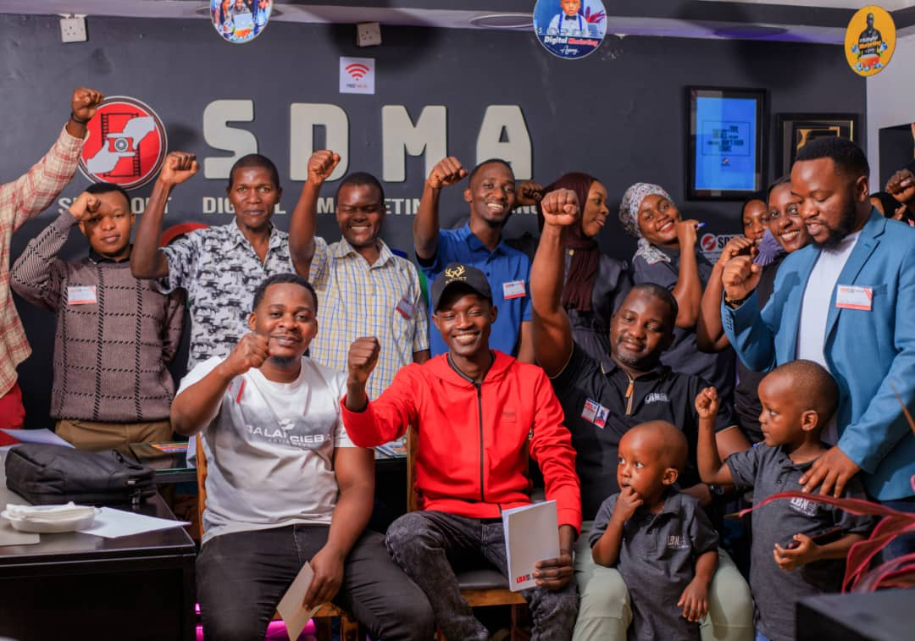

Closing Message
Members,
Foundation is not built in one day.
It is built through:
✔ Consistency
✔ Discipline
✔ Commitment
If we get this right from the beginning…
👉 This will not be just a meeting
👉 This will become a business engine
FOUNDER CHAPTER

Slide 16

Final Statement
“Let us build this chapter (Founder) with seriousness, structure, and commitment because what we build today will determine what we earn tomorrow.”
FOUNDER CHAPTER

